Slide 1
Boosting Algorithm Regression
Type of Boosting Algorithm
ADA Boost
2.XG Boost
3.LG Boost

Slide 2
ADA Boosting – Regression
Quick Explanation
Ada Boost is an ensemble model that sequentially builds new models based on the errors of the previous model to improve the predictions.
Adaptive Boosting (Ada Boost) is an ensemble learning technique that combines multiple weak regressors to create a strong predictive model
Key Features
Assigns weights to training samples, increasing emphasis on poorly predicted points.
Uses weighted averaging to make final predictions.
Robust to outliers but sensitive to noisy data.

Slide 3
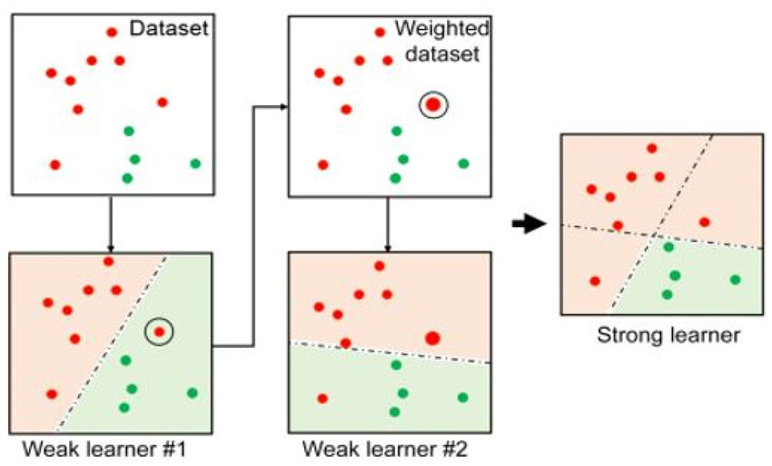
ADA Boosting – Regression
https://www.researchgate.net/figure/Flow-diagram-for-AdaBoost-regression_fig2_382181243

Slide 4

XG Boosting – Regression
Quick Explanation:
eXtreme Gradient Boosting (XGBoost) is a scalable and improved version of the gradient boosting algorithm (terminology alert) designed for efficacy,
computational speed and model performance. It is an open-source library and a part of the Distributed Machine Learning Community.
XGBoost is a perfect blend of software and hardware capabilities designed to enhance existing boosting techniques with accuracy in the shortest amount of time.
Capital F(i) is current model, F(i-1) is previous model and small f(i) represents a weak model

Slide 5
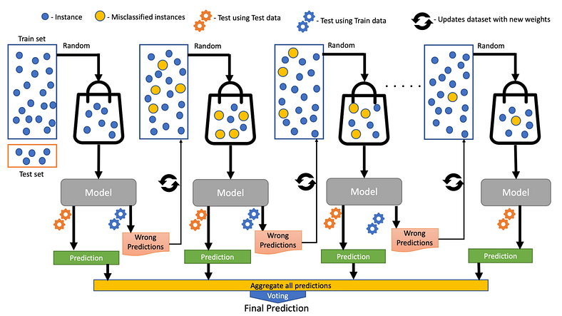
XG Boosting – Regression

Slide 6
LG Boosting – Regression
Quick Explanation:
LightGBM (Light Gradient Boosting Machine) is a gradient boosting framework, a type of machine learning algorithm that builds predictive models by sequentially adding weak learners (like decision trees,
Key Features of LightGBM:
Leaf-wise Growth
Distributed and Parallel
Histogram-based Algorithm
Wide Applications
DB XG Boost vs LG Boost:
In contrast to the level-wise (horizontal) growth in XGBoost,
LightGBM carries out leaf-wise (vertical) growth that results in more loss reduction and, in turn, higher accuracy while being faster

Slide 7
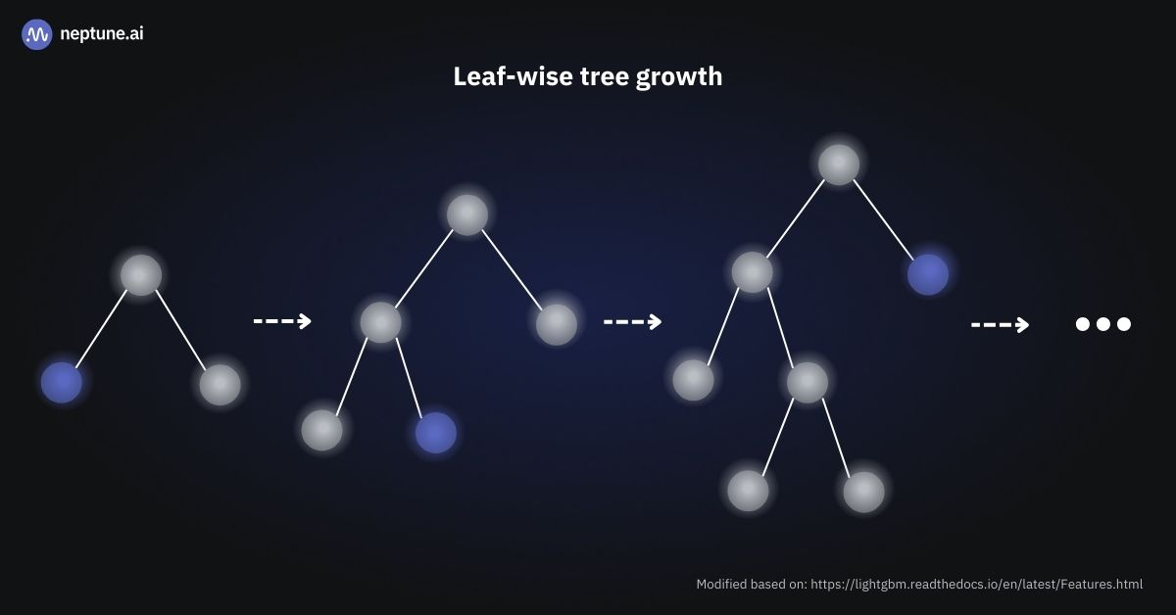
LG Boosting – Regression
Leaf-wise tree growth: Visualization of a binary tree expanding incrementally, prioritizing the growth of leaf nodes before adding new levels.

Slide 8
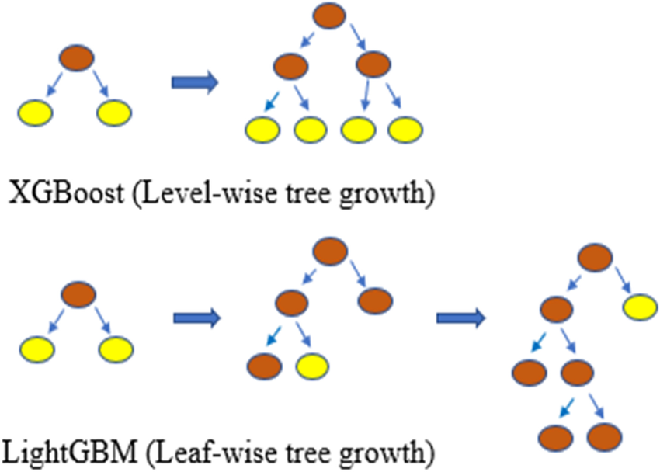
LG Boosting – Regression

